Slide 1

The Machine Learning Process
Python 101 – Functions
Sathish Ravichandran

Slide 2

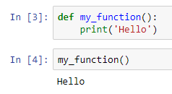
What is Function?
It is block of code that can be easily executed many times, without writing it repeatedly.
Syntax:
def function_name():
#block of code
Notes:
def my_function():
print('Hello’)
my_function()

Slide 3
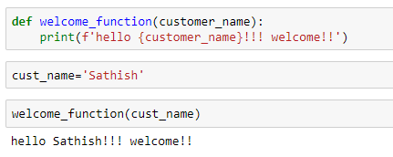


Function with parameters
Some useful information can be passed to function as parameters
Syntax:
def function_name(parameters_name):
#block of code
Notes:
def welcome_function(customer_name):
print(f'hello {customer_name}!!! welcome!!’)
cust_name='Sathish’
welcome_function(cust_name)

Slide 4
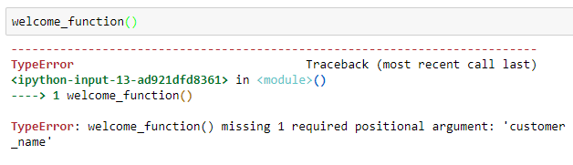
Function with parameters
What will happen if we call a parameterized function without a parameter?
How do we fix this? Let's discuss
Notes:
def welcome_function(customer_name):
print(f'hello {customer_name}!!! welcome!!’)
cust_name='Sathish’
welcome_function(cust_name)

Slide 5
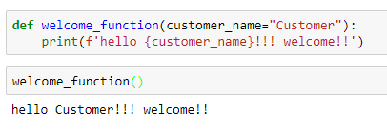
Function with parameters
We can fix the issue by giving default parameter value
Notes:
def welcome_function(customer_name="Customer"):
print(f'hello {customer_name}!!! welcome!!’)
welcome_function()

Slide 6
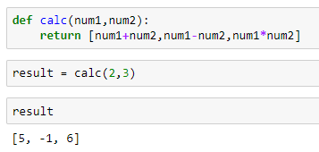






Function with return value
In most cases we will write a function that returns a value
The return statement returns the value to the place where the function is called
Notes:
def calc(num1,num2):
return [num1+num2,num1-num2,num1*num2]
result = calc(2,3)

Slide 7
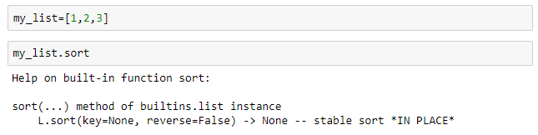
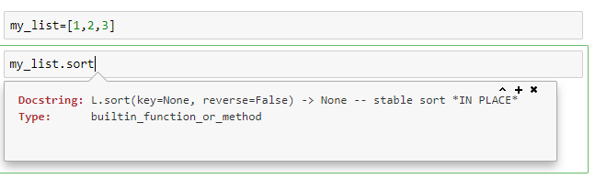
Python -Help
Python has a built-in help function which can be accessed by the following ways
Help Keyword
Shift+Tab key
Notes:
my_list=[1,2,3]
my_list.sort

Slide 8
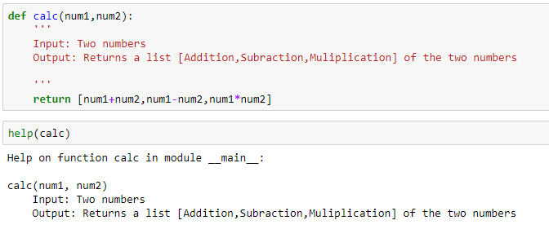
Python -Help
Imagine if someone else is using the function that you wrote.
How will they understand the purpose of your function?
That’s why we use DOCSTRING
We can enter the information and purpose of the function between ‘‘’ Function_Information ‘‘’
Notes:
def calc(num1,num2):
'''
Input: Two numbers
Output: Returns a list [Addition,Subraction,Muliplication] of the two numbers
'''
return [num1+num2,num1-num2,num1*num2]
help(calc)

Slide 9
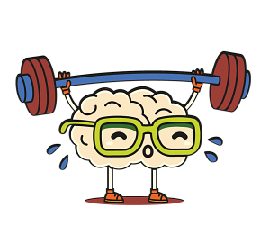
Learning Exercise 01
Write a function which returns the number of vowels in your name
Expected output:
print(count_vowels(‘Sathish’))
-> 2
Notes:
##Changing the title position

Slide 10

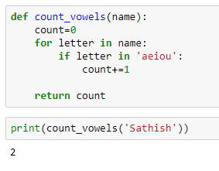
Solution
Notes:
def count_vowels(name):
count=0
for letter in name:
if letter in 'aeiou':
count+=1
return count
print(count_vowels('Sathish'))

Slide 11
Learning Exercise 02
Write a function which reverses the characters in your name
Expected output:
print(reverse_name(‘Sathish’))
-> hsihtaS

Slide 12
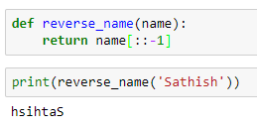
Solution
There are many ways to do this
Here is the easiest way
Notes:
def reverse_name(name):
return name[::-1]
print(reverse_name('Sathish'))

Slide 13

Scenario 01
What if we want to reverse the name of all the students in the class??
We will be calling the function every time!!!!
This is not feasible for large set of data

Slide 14
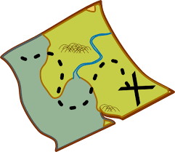
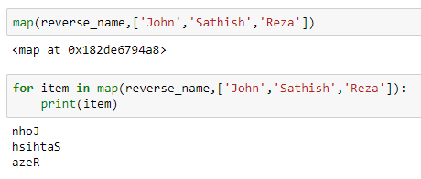
Map
Map is a built-in python function which will execute a specified function for each item in an iterable.
Notes:
def reverse_name(name):
return name[::-1]
for item in map(reverse_name,['John','Sathish','Reza']):
print(item)

Slide 15


Lambda expression
A lambda expression is an anonymous function, which can take any number of arguments, but can have only one expression
Syntax:
lambda arguments : expression
Notes:
lambda name:name[::-1]

Slide 16
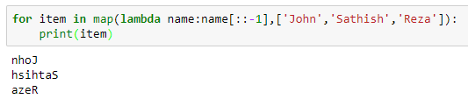

Lambda expression in map
Or
Notes:
for item in map(lambda name:name[::-1],['John','Sathish','Reza']):
print(item)
or
list(map(lambda name:name[::-1],['John','Sathish','Reza']))

Slide 17

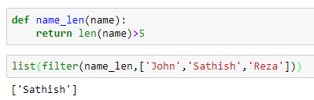

Filter
Creates a list if the function returns true
Using lambda expression
Notes:
def name_len(name):
return len(name)>5(lambda name:name[::-1],['John','Sathish','Reza’]))
list(filter(name_len,['John','Sathish','Reza’]))
or
list(filter(lambda name:len(name)>5,['John','Sathish','Reza']))

Slide 18
Thank you
The Capacity to learn is a gift;
The ability to learn is a skill;
The willingness to learn is a choice.
-Brian Herbert

